Slide 1
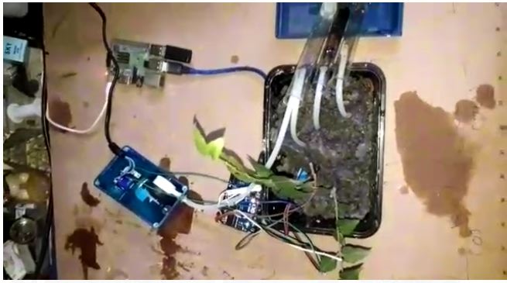
Financial Implication of the village

Slide 2

Making India socialist
Fairly equal distribution of wealth
Stable Prolonged crop production
Raising income of poor farmers

Slide 3

Implement Newer Technologies
Added Monetary Benefit leads us to buy more sophisticated gadgets
Raise economic standards and living health

Slide 4
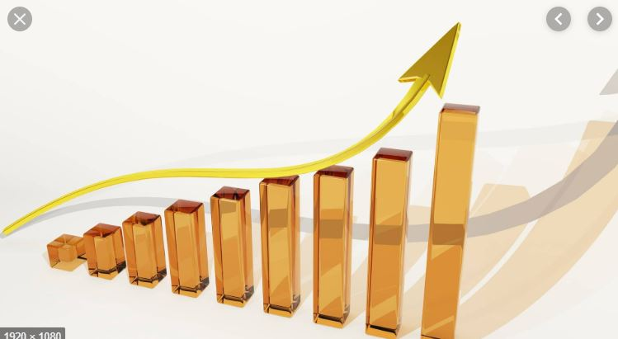
Raise Overall Profit
Increased agriculture increases the value of money
Inflammation goes down which reduces cost
Poor farmers can educate themselves with the money earned which fights the problem at the very root

